Slide 1

A new era for Vermont’s development
Engaging in comprehensive act 250 reform

Slide 2
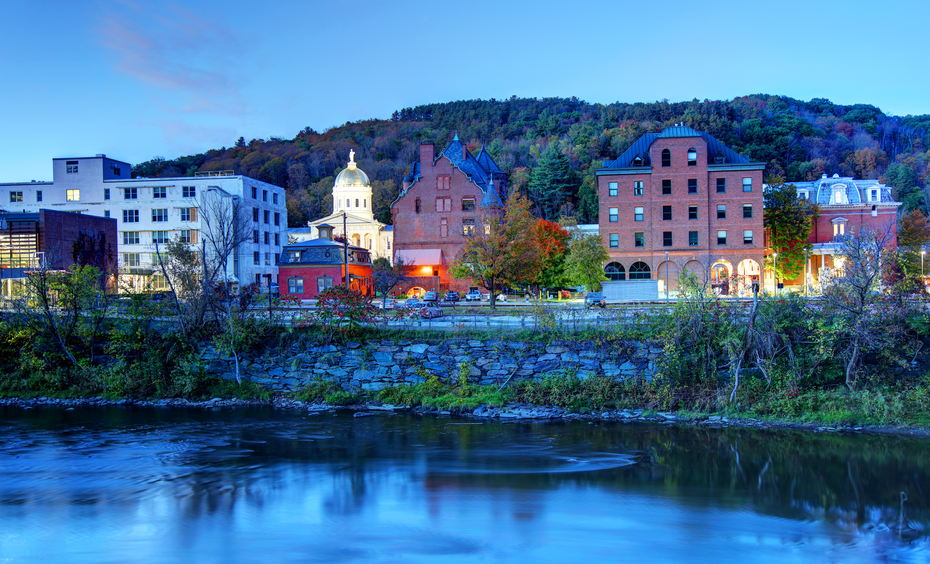

VERMONT CHAMBER OF COMMERCE
OUR MISSION
ADVANCING THE VERMONT ECONOMY
Trusted by the businesses that make living, working, and thriving in Vermont possible, we prioritize collaboration and uphold the core values that define our state. As the preeminent not-for-profit business organization, we advocate, build community, and provide resources for businesses statewide.

Slide 3
Poll- What Act 250 Quote do you most identify with?
Take The Poll on the Whova App or log into the Whova Website

Slide 4
Session Goal
My Goal
  Create Awareness of the current study on Act 250 and proposal that is going to the legislature in January
  Understand areas that Act 250 is and isn’t working for the development community.
  Gain SMART (specific, measurable, achievable, relevant, timely) feedback to influence legislative advocacy and action to move into the next evolution of Vermont land use policy.
What are your goals for this session?

Slide 5
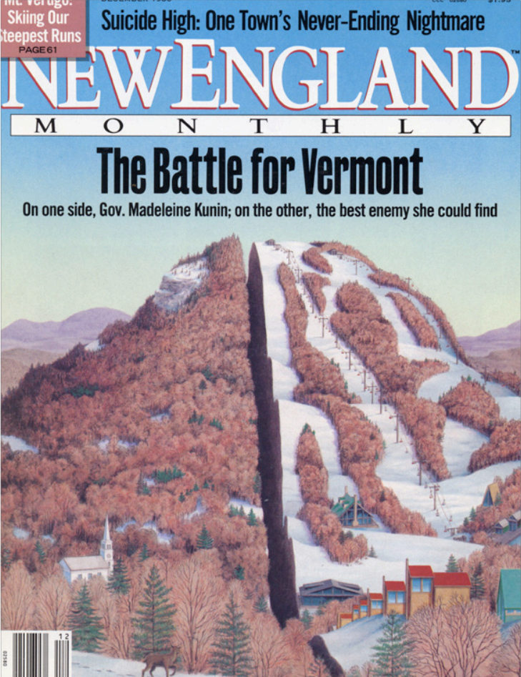
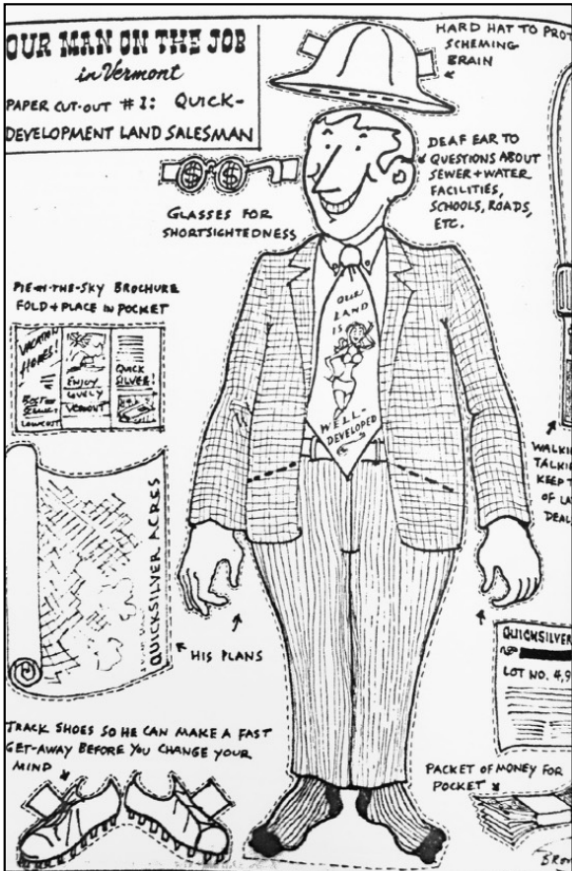
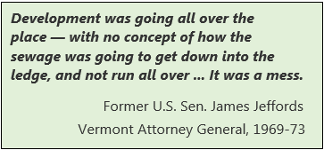
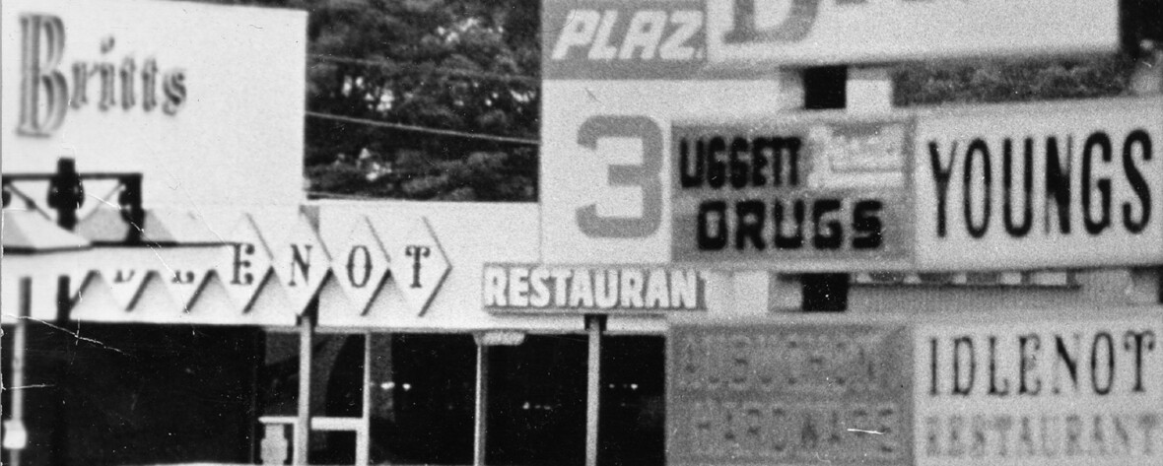
History of Act 250

Slide 6
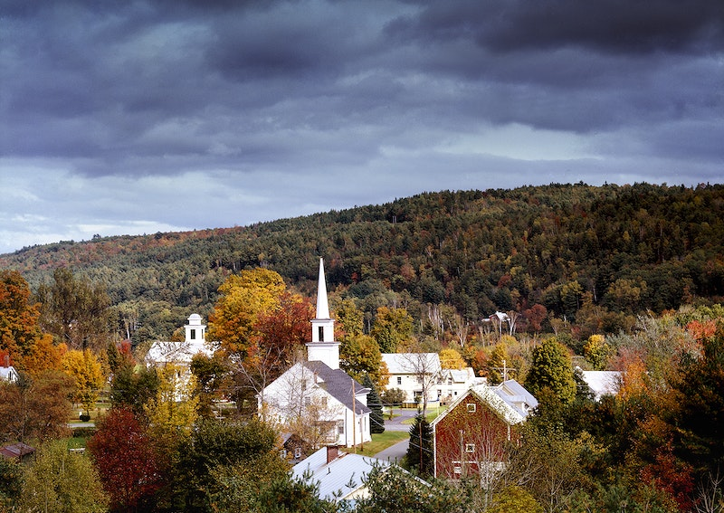
Overview of Act 250- NRB Website
The law provides a public, quasi-judicial process for reviewing and managing the environmental, social and fiscal consequences of major subdivisions and developments in Vermont.
It assures that larger developments compliment Vermont’s unique landscape, economy and community needs.
One of the strengths of Act 250 is the access it provides to neighbors and other interested parties to participate in the development review process.

Slide 7
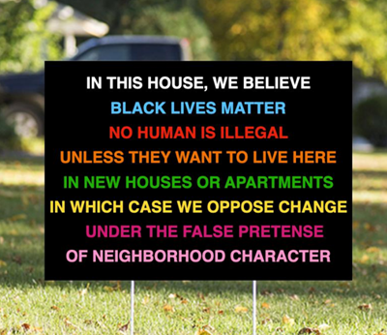

Slide 8
Act 250 Criteria
Criterion 1: Air and water pollution
  1(A): Headwaters
  1(B): Waste disposal
  1(C): Water conservation
  1(D): Floodways
  1(E): Streams
  1(F): Shorelines
  1(G): Wetlands
Criterion 2: Water supply
Criterion 3: Impact on water supply
Criterion 4: Erosion and capacity of soil to hold water
Criterion 5: Transportation
  5(A): Traffic
  5(B): Transportation
Criterion 6: Educational services
Criterion 7: Municipal services
Criterion 8: Aesthetics, scenic and natural beauty
  Historic sites
  Historic sites - archeology
  Rare and irreplaceable natural areas
  8(A): Necessary wildlife habitat
Criterion 9
  9(A): Impact of growth
  9(B): Primary agricultural soils
  9(C): Productive forest soils
  9(D): Earth resources
  9(E): Extraction of earth resources
  9(F): Energy conservation
  9(G): Private utility services
  9(H): Costs of scattered development
  9(J): Public utility services
  9(K): Public investments
  9(L): Settlement patterns (formerly "Rural growth areas")
Criterion 10: Local and regional plans

Slide 9
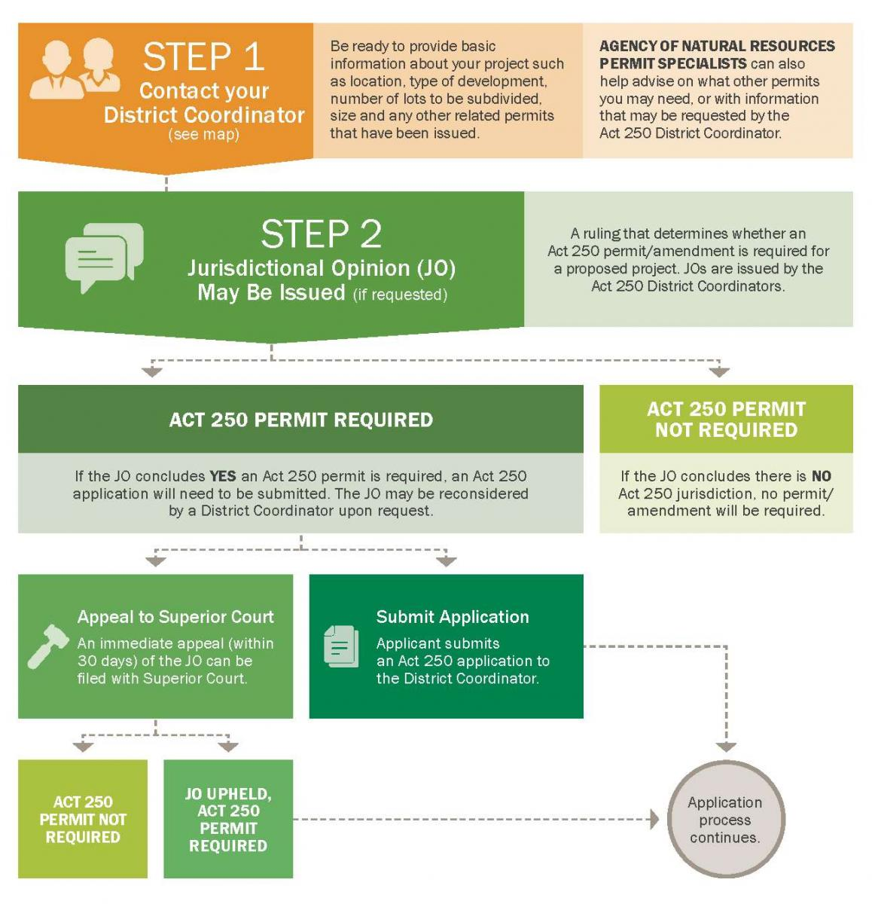
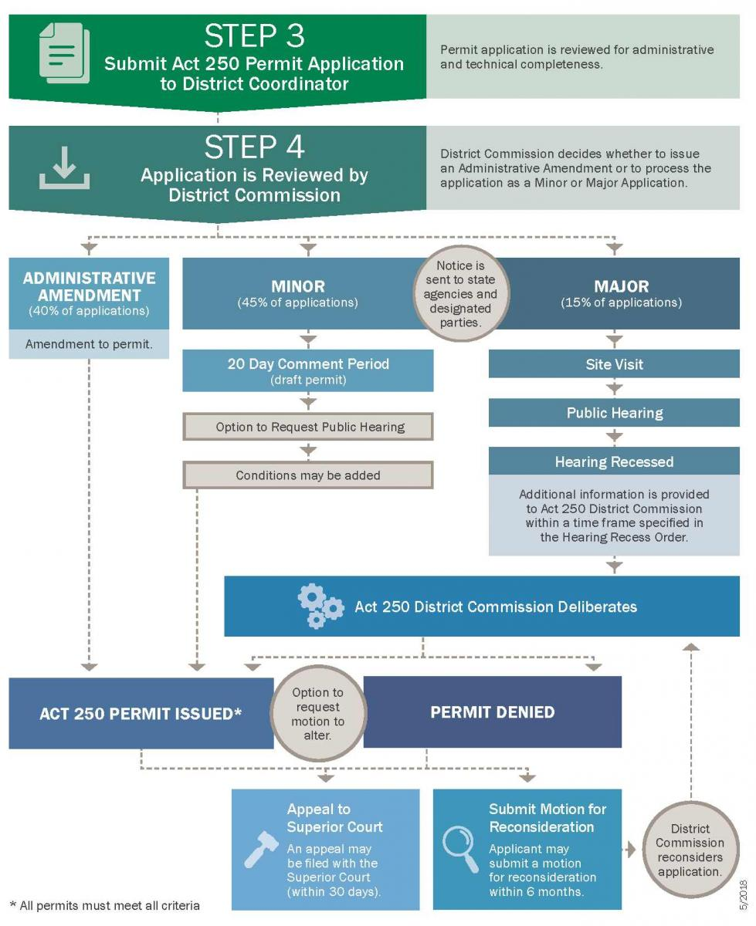
Act 250 Process

Slide 10


What is your Act 250 experience?
Notes:
Do you not understand what the big deal is or do you think it is unpredictable and complicated?

Slide 11
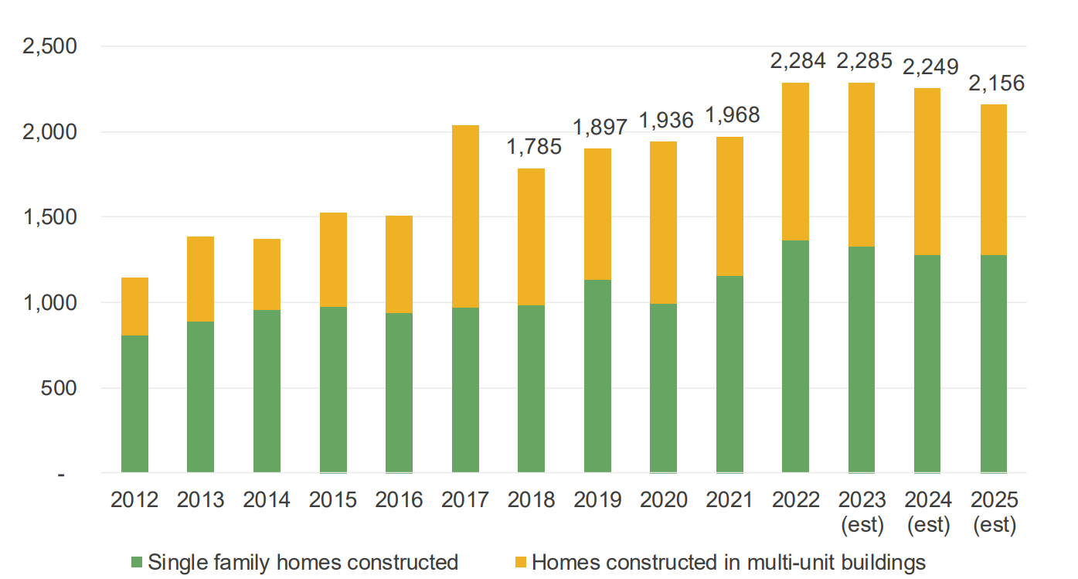
Housing Needs

Slide 12
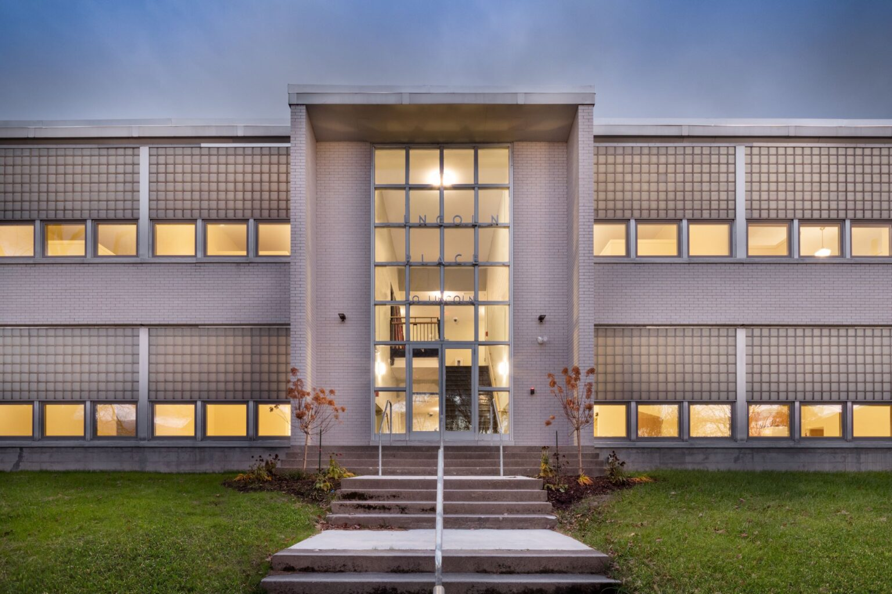
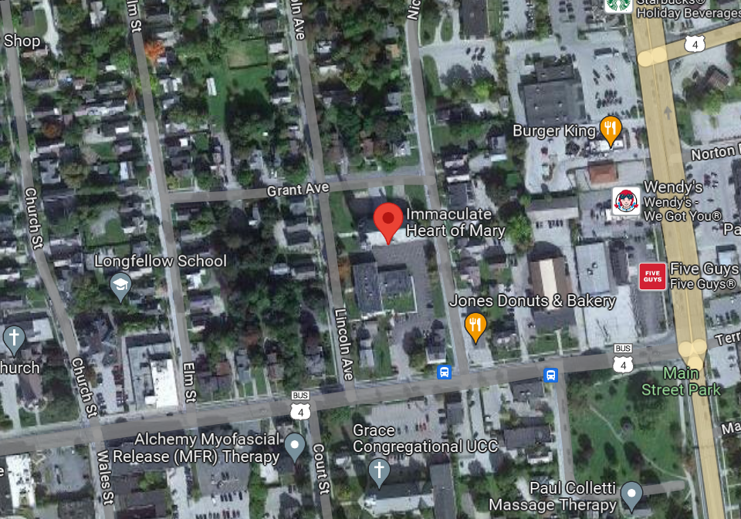
Why this?
Notes:
Lincoln Place, the former Immaculate Heart of Mary School, is 19 one bedroom and micro units for low income and formerly homeless residents of our community. The property offers several community spaces, onsite laundry and services that resident may need in partnership with Community Care Network/RMHS, Homeless Prevention Center and Rutland Housing Authority. All units are subsidized. Rent includes all utilities. $31K

Slide 13
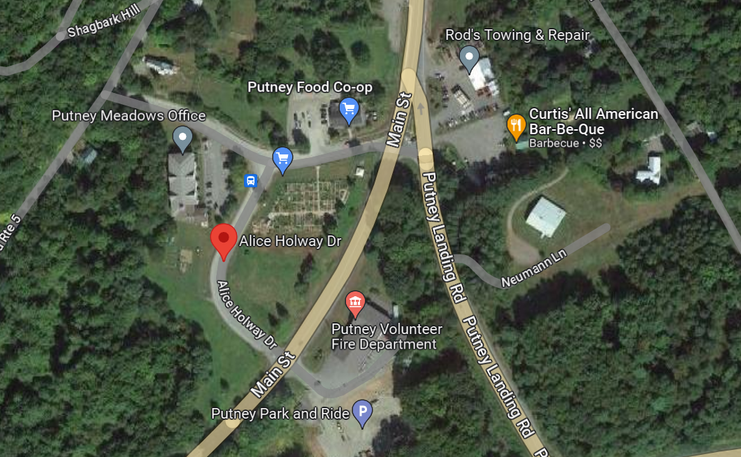
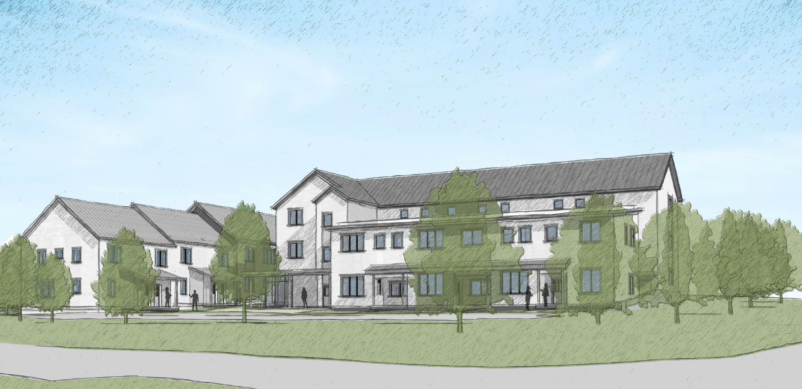
And This?

Slide 14
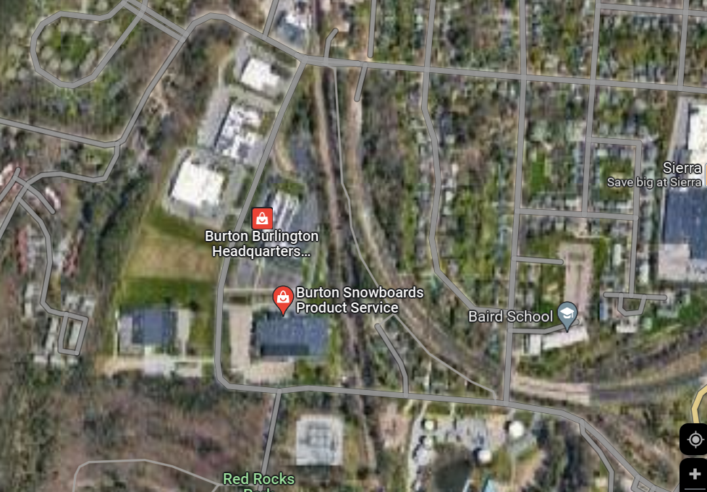
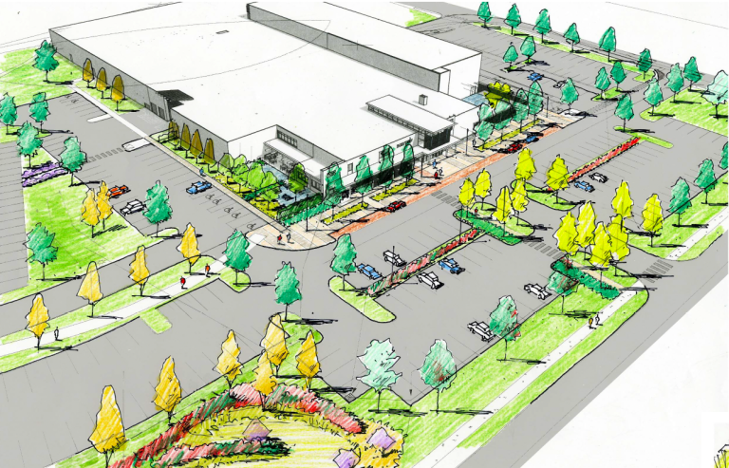
And This?

Slide 15
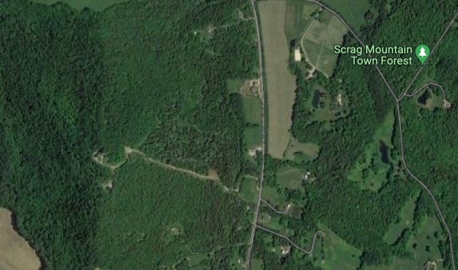
And Not That?

Slide 16
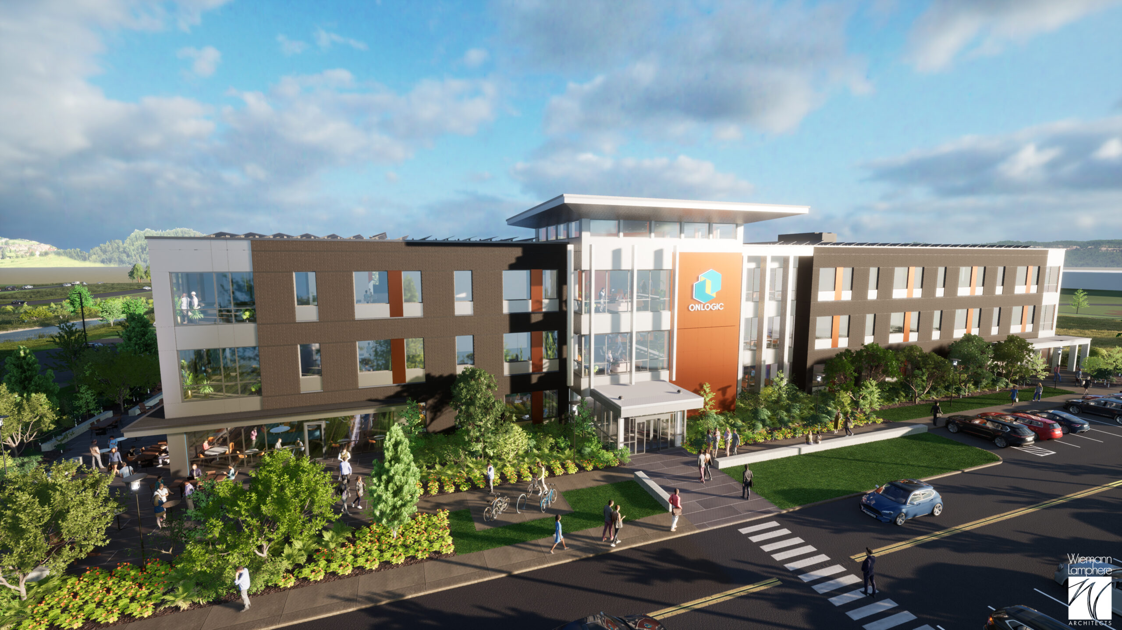
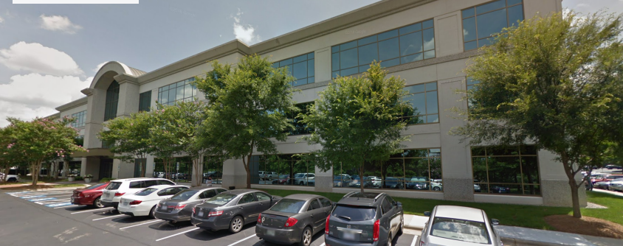
Problems- Process and Reputational
OnLogic
Cary, North Carolina
OnLogic
South Burlington

Slide 17
Let’s Study It!
Natural Resources Board Act 250 Necessary Updates
  Location-based jurisdiction
  NRB staffing assessment
  Sufficiency of permit fees
  Effectiveness of permit fees in providing appropriate incentives
  Whether the Board should be able to assess its costs on applicants
  Increasing jurisdictional thresholds for housing to 25 units
  Delegation of administration of Act 250 permits to municipalities

Slide 18
Updated Proposal on Jurisdiction
1A. Large municipalities/ similar to downtown designations | 1B. Municipalities with zoning and subdivision regs and capacity for growth | 2. Open undeveloped land not in Tiers 1 or 3 | 3. Sensitive Natural Resource Areas
-Requirement that zoning and subdivision regs meet established standards -Municipality proposes designated area for approval by state board; RPC review/ concurrence -All residential, commercial, and industrial projects within 1A exempt from Act 250 | -Capacity includes either infrastructure or the right soil conditions to handle wastewater -Regulations and/or planning and administrative capacity do not meet Tier 1A standards -Municipality proposes designated area for approval by state board; RPC review/ concurrence -In order to promote density, no jurisdictional trigger on number of units -6/10 lot jurisdictional trigger over 3 years. | -Open undeveloped land including small villages/hamlets without zoning, subdivision, capacity -All land that is not in Tiers 1A/B, or 3 -Status quo on lots and units (10 units/ 6 lots with the 5/5) -Road rule jurisdictional trigger applies. Any combination of road and driveway over 2,000 feet. | -Agreement on high level that a tier 3 should be further considered. - Needs to follow same public process as Tier 1. -Automatic jurisdictional trigger -Subset of highly sensitive natural resources

Slide 19
Updated Proposal on Governance
Board Structure and Authority | Appeals | Fees | Rebuttable Presumptions
-3-5 person professional board -relevant backgrounds in land use planning, engineering, environmental law, environmental science… - Emphasis on rule making authority -JO Reconsiderations going to the NRB with appeal to the supreme court | -No consensus -Regardless of which model is chosen having it take 12-24 months kills a project, and that’s what we have now. -Exemptions may help- acknowledging a housing crisis | -Challenges - Tier exemptions will reduce fee income to fund NRB’s current and expanded function. - Fees increase when project costs increase. Should we be charging more for things like efficiency and resiliency in housing? -NRB needs to be adequately resourced with respect to compensation framework and agency resources. | - Changing rebuttable presumptions to make it dispositive. - Applies only in areas where other permits directly overlap with relevant Act250 criterion.

Slide 20
Small Group Discussions
Looking at this as a package deal
  What do you love?
  what do you like?
  What can you accept?
  What is a dealbreaker?
Think Outside the Study
  What wasn’t considered?
  What else needs to change?
  What are your ideas on fees and costs?

Slide 21
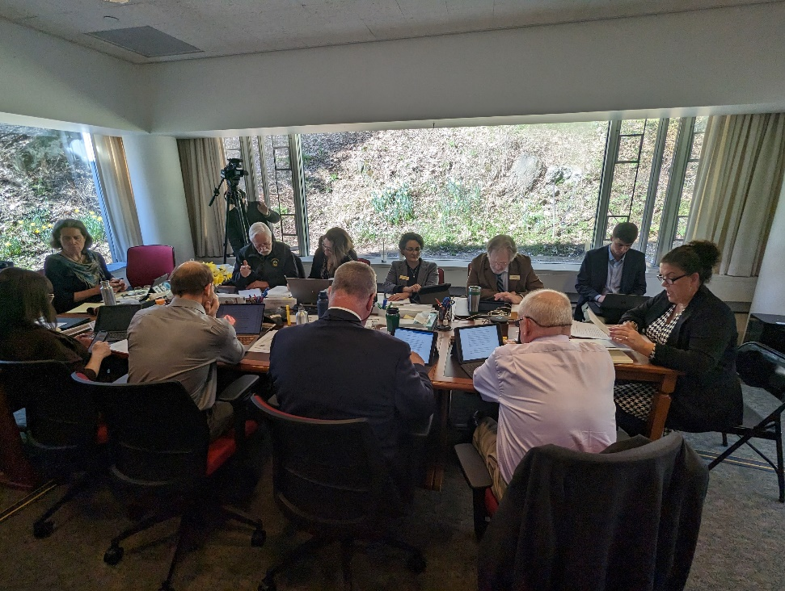
Let’s Act On It!
Attend the Public Meetings and provide comment
Submit written comments on draft report
Call your legislator and talk about this before and during the legislative session

Slide 22
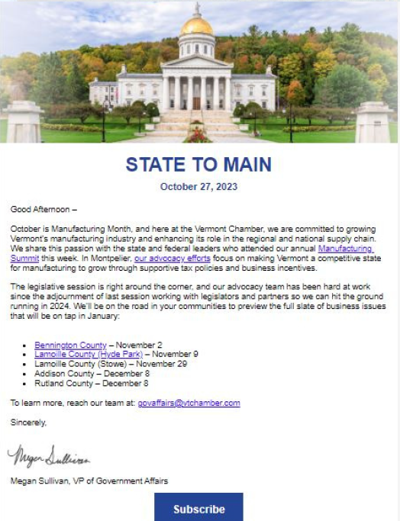
STAY IN THE KNOW
AND ENGAGED

Slide 23

QUESTIONS?
Megan Sullivan
Vermont Chamber of Commerce
Msullivan@vtchamber.com
(802)522-6316

